Slide 1
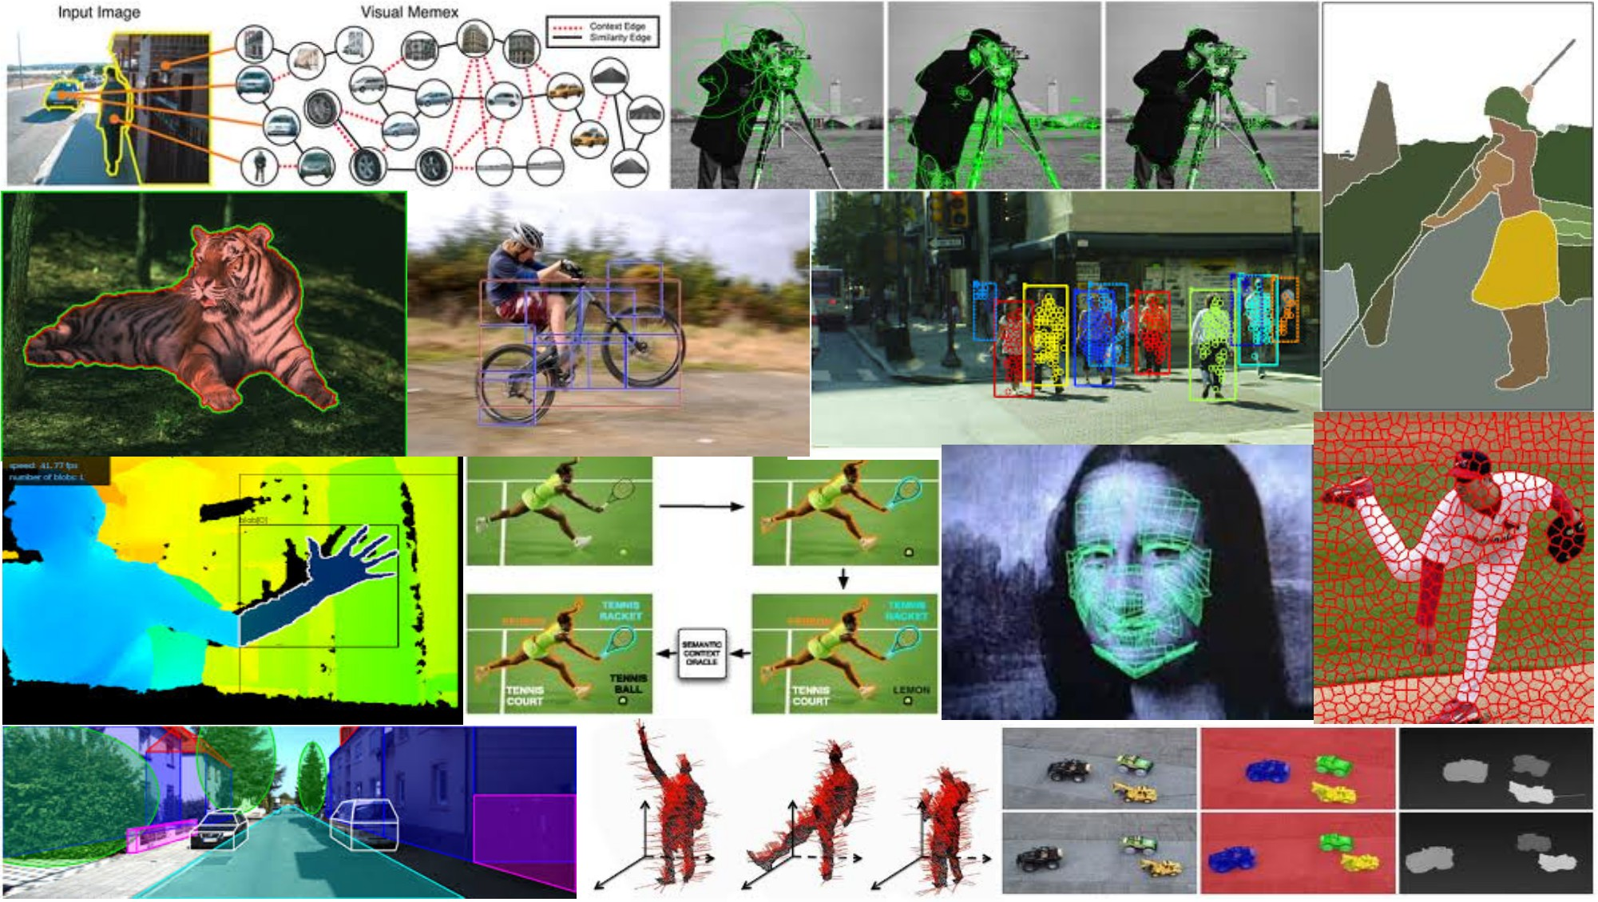
Fitting a transformation: Feature-based alignment May 1st, 2018
Yong Jae Lee
UC Davis

Slide 2
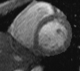
Last time: Deformable contours
a.k.a. active contours, snakes
Given: initial contour (model) near desired object
Goal: evolve the contour to fit exact object boundary
Main idea: elastic band is iteratively adjusted so as to
be near image positions with high gradients, and
satisfy shape “preferences” or contour priors
[Snakes: Active contour models, Kass, Witkin, & Terzopoulos, ICCV1987]
Figure credit: Yuri Boykov

Slide 3
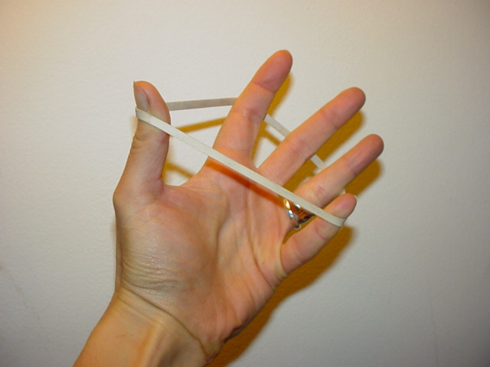
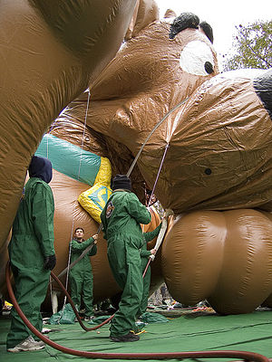
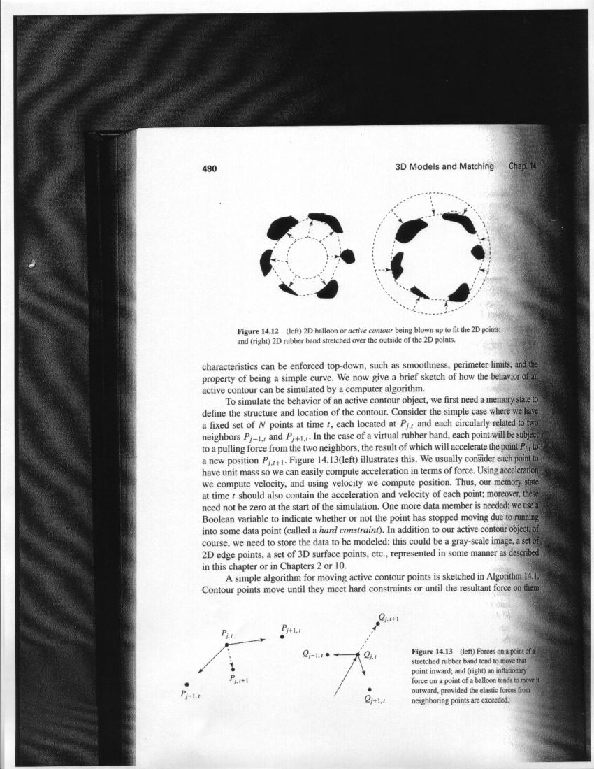
Last time: Deformable contours
Image from http://www.healthline.com/blogs/exercise_fitness/uploaded_images/HandBand2-795868.JPG

Slide 4
Last time: Deformable contours
Pros:
Useful to track and fit non-rigid shapes
Contour remains connected
Possible to fill in “subjective” contours
Flexibility in how energy function is defined, weighted.
Cons:
Must have decent initialization near true boundary, may get stuck in local minimum
Parameters of energy function must be set well based on prior information
Kristen Grauman

Slide 5
Today
Interactive segmentation
Feature-based alignment
2D transformations
Affine fit
RANSAC

Slide 6

Interactive forces
How can we implement such an interactive force with deformable contours?
Kristen Grauman

Slide 7
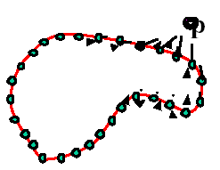
Interactive forces
An energy function can be altered online based on user input – use the cursor to push or pull the initial snake away from a point.
Modify external energy term to include a term such that
Nearby points get pushed hardest
Adapted by Devi Parikh from Kristen Grauman

Slide 8
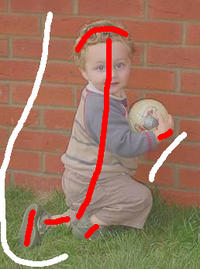
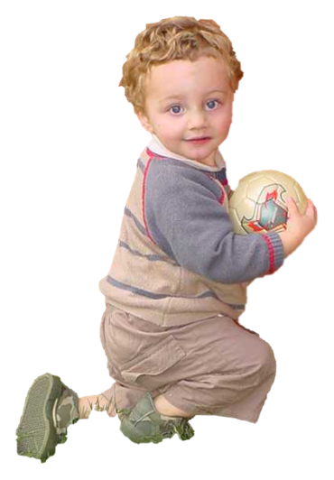
Beyond boundary snapping…
Another form of interactive guidance: specify regions
Usually taken to suggest foreground/background color distributions
User Input
Result
How to use this information?
Boykov and Jolly (2001)

Slide 9
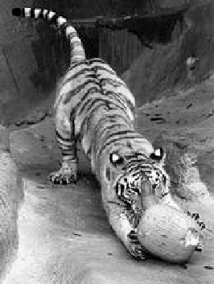
Recall: Images as graphs
q
w_{pq}
w
p
Fully-connected graph
node for every pixel
link between every pair of pixels, p,q
similarity w_{pq} for each link
similarity is inversely proportional to difference in color and position
Steve Seitz

Slide 10
Recall: Segmentation by Graph Cuts
w
A
B
C
Break graph into segments
Delete links that cross between segments
Easiest to break links that have low similarity
similar pixels should be in the same segments
dissimilar pixels should be in different segments
Steve Seitz

Slide 11
Recall: Segmentation by Graph Cuts
B
A
Link Cut
set of links whose removal makes a graph disconnected
cost of a cut:
Find minimum cut
gives you a segmentation
fast algorithms exist for doing this
Source: Steve Seitz

Slide 12
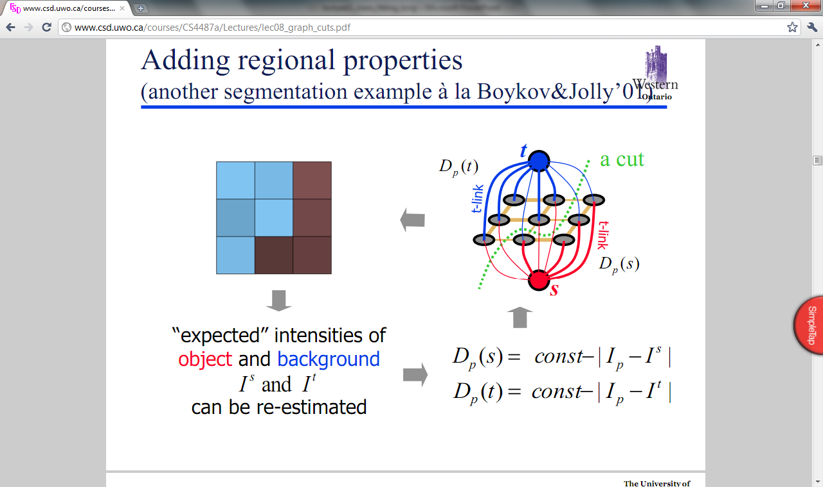
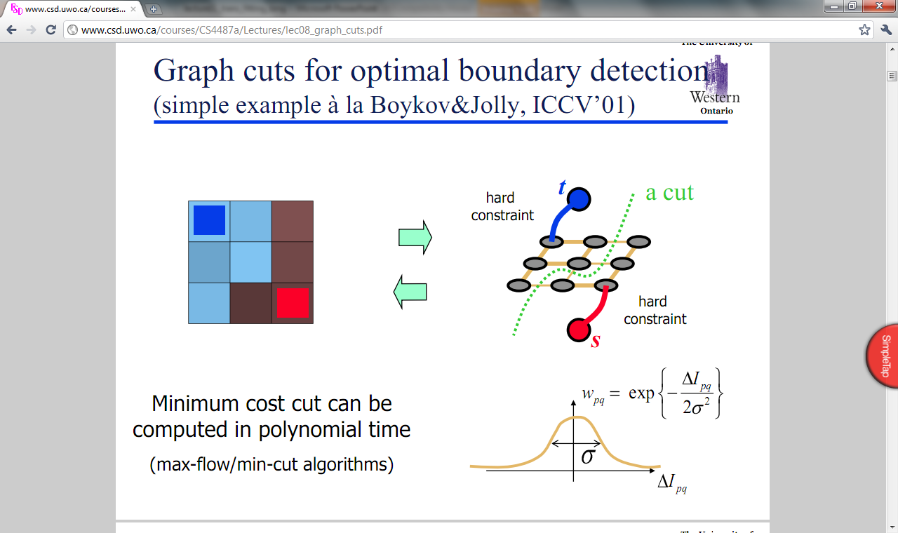
Graph cuts for interactive segmentation
Adding hard constraints:
Add two additional nodes, object and background “terminals”
Link each pixel
To both terminals
To its neighboring pixels
Yuri Boykov

Slide 13
Graph cuts for interactive segmentation
Adding hard constraints:
Let the edge weight to object or background terminal reflect distance to the respective seed pixels.
Yuri Boykov

Slide 14
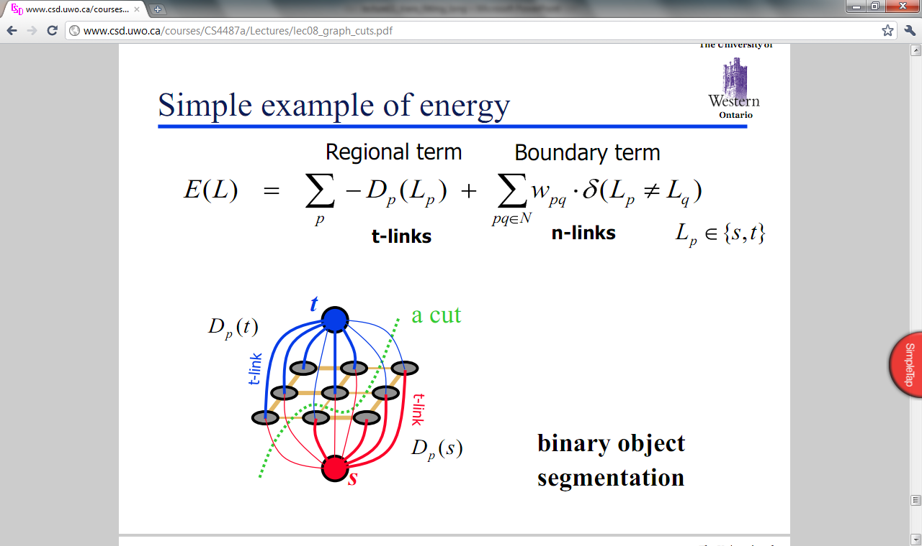
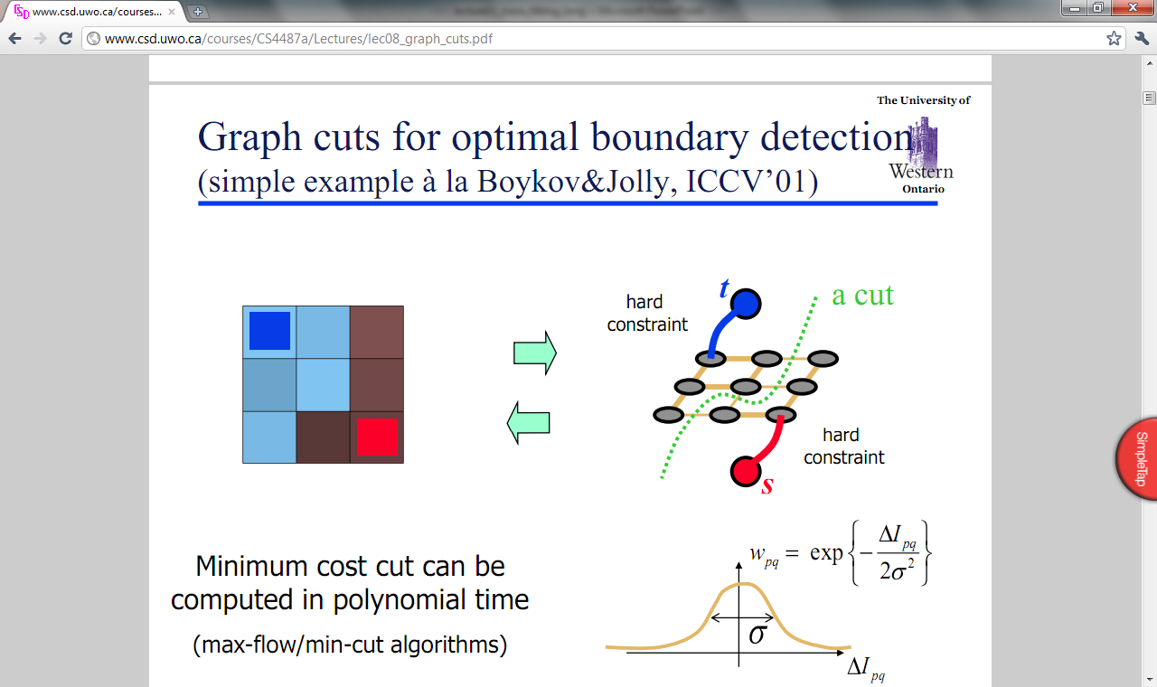
Graph cuts for interactive segmentation
Boykov and Jolly (2001)

Slide 15
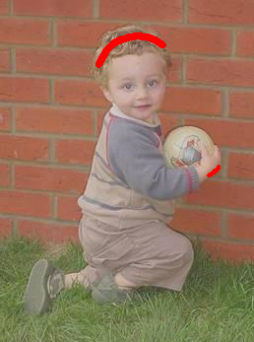

Graph cuts for interactive segmentation
Another interaction modality: specify bounding box
Graph Cuts Boykov and Jolly (2001)
GrabCut Rother et al. (2004)
Slide credit: Kristen Grauman

Slide 16
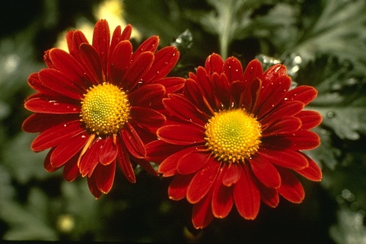

“Grab Cut”
Loosely specify foreground region
Iterated graph cut
?
User Initialisation
User initialization
Graph cuts to infer the segmentation
K-means for learning colour distributions
Rother et al (2004)

Slide 17

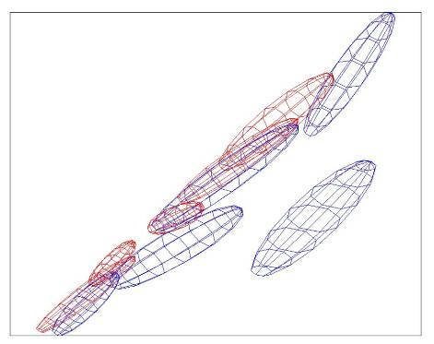
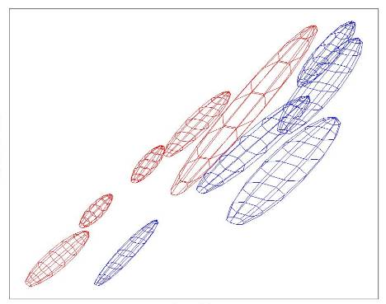
“Grab Cut”
Loosely specify foreground region
Iterated graph cut
R
R
Foreground & Background
Iterated graph cut
Foreground
Background
G
Background
G
Gaussian Mixture Model (typically 5-8 components)
Rother et al (2004)

Slide 18
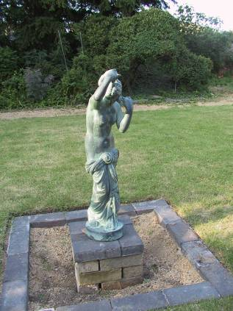
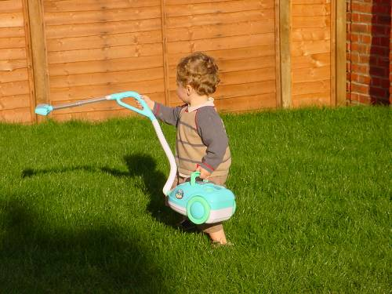

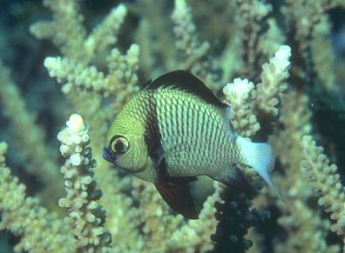
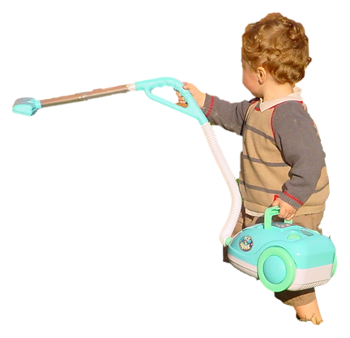
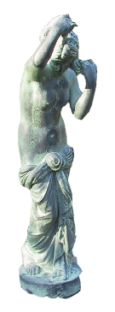

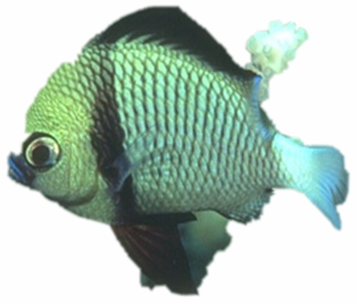
“Grab Cut”
Rother et al (2004)

Slide 19
Today
Interactive segmentation
Feature-based alignment
2D transformations
Affine fit
RANSAC

Slide 20
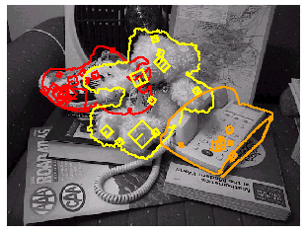
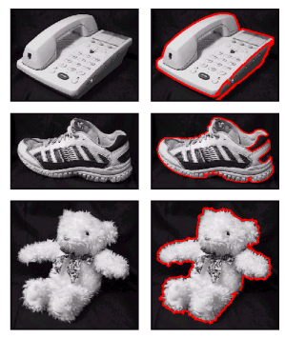
Motivation: Recognition
Figures from David Lowe

Slide 21
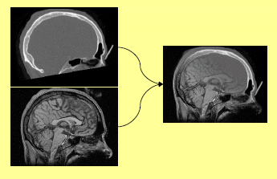
Motivation: medical image registration
Slide credit: Kristen Grauman

Slide 22
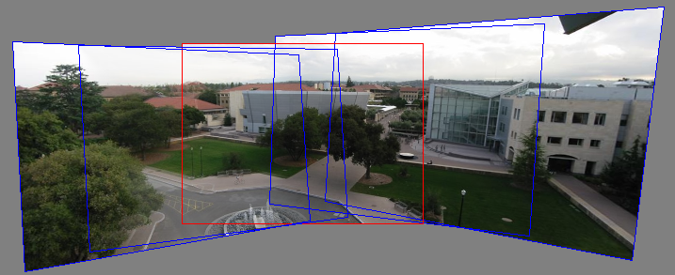
Motivation: mosaics
(In detail next week)
Image from http://graphics.cs.cmu.edu/courses/15-463/2010_fall/

Slide 23
Alignment problem
We have previously considered how to fit a model to image evidence
e.g., a line to edge points, or a snake to a deforming contour
In alignment, we will fit the parameters of some transformation according to a set of matching feature pairs (“correspondences”).
x_{i}
x_{i}
'
T
Slide credit: Kristen Grauman

Slide 24
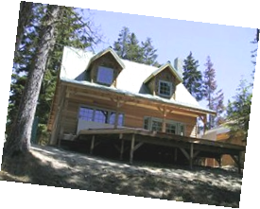
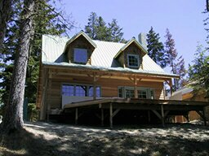
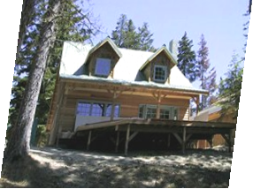
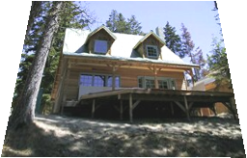
Parametric (global) warping
Examples of parametric warps:
translation
rotation
aspect
perspective
affine
Source: Alyosha Efros

Slide 25
Parametric (global) warping
T
p = (x,y)
p’ = (x’,y’)
Transformation T is a coordinate-changing machine:
p’ = T(p)
What does it mean that T is global?
Is the same for any point p
can be described by just a few numbers (parameters)
Let’s represent T as a matrix:
p’ = Mp
Source: Alyosha Efros

Slide 26
Scaling
Scaling a coordinate means multiplying each of its components by a scalar
Uniform scaling means this scalar is the same for all components:
× 2
Source: Alyosha Efros

Slide 27
Scaling
Non-uniform scaling: different scalars per component:
X × 2, Y × 0.5
Source: Alyosha Efros

Slide 28
Scaling
Scaling operation:
Or, in matrix form:
scaling matrix S
Source: Alyosha Efros

Slide 29
What transformations can be represented with a 2x2 matrix?
2D Scaling?
2D Rotate around (0,0)?
2D Shear?
Source: Alyosha Efros

Slide 30
What transformations can be represented with a 2x2 matrix?
2D Mirror about Y axis?
2D Mirror over (0,0)?
2D Translation?
NO!
Source: Alyosha Efros

Slide 31
2D Linear Transformations
Only linear 2D transformations can be represented with a 2x2 matrix.
Linear transformations are combinations of …
Scale,
Rotation,
Shear, and
Mirror
Source: Alyosha Efros

Slide 32
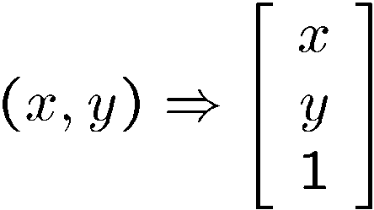
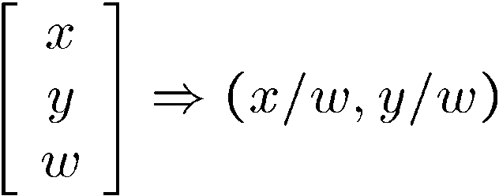
Homogeneous coordinates
Convenient coordinate system to represent many useful transformations
To convert to homogeneous coordinates:
homogeneous image
coordinates
Converting from homogeneous coordinates:
Slide credit: Kristen Grauman
Notes:
coordinates used in projective geometry.
Homogeneous coordinates have an extra dimension called W, which scales the X, Y dimensions.
Can model points at infinity (when w = 0)

Slide 33
Homogeneous Coordinates
Q: How can we represent 2d translation as a 3x3 matrix using homogeneous coordinates?
A: Using the rightmost column:
Source: Alyosha Efros

Slide 34
Translation
Homogeneous Coordinates
t_{x} = 2 t_{y} = 1
Source: Alyosha Efros

Slide 35
Basic 2D Transformations
Basic 2D transformations as 3x3 matrices
Translate
Scale
Rotate
Shear
Source: Alyosha Efros

Slide 36
2D Affine Transformations
Affine transformations are combinations of …
Linear transformations, and
Translations
Parallel lines remain parallel
Slide credit: Kristen Grauman

Slide 37
Today
Interactive segmentation
Feature-based alignment
2D transformations
Affine fit
RANSAC

Slide 38
Alignment problem
We have previously considered how to fit a model to image evidence
e.g., a line to edge points, or a snake to a deforming contour
In alignment, we will fit the parameters of some transformation according to a set of matching feature pairs (“correspondences”).
x_{i}
x_{i}
'
T
Kristen Grauman

Slide 39
Image alignment
Two broad approaches:
Direct (pixel-based) alignment
Search for alignment where most pixels agree
Feature-based alignment
Search for alignment where extracted features agree
Can be verified using pixel-based alignment
Slide credit: Kristen Grauman

Slide 40
Fitting an affine transformation
Assuming we know the correspondences, how do we get the transformation?
Slide credit: Kristen Grauman

Slide 41
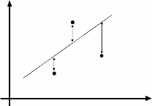
An aside: Least Squares Example
Say we have a set of data points (X1,X1’), (X2,X2’), (X3,X3’), etc. (e.g. person’s height vs. weight)
We want a nice compact formula (a line) to predict X’s from Xs: Xa + b = X’
We want to find a and b
How many (X,X’) pairs do we need?
What if the data is noisy?
Ax=B
overconstrained
Source: Alyosha Efros

Slide 42
Fitting an affine transformation
Assuming we know the correspondences, how do we get the transformation?
Slide credit: Kristen Grauman

Slide 43
Fitting an affine transformation
How many matches (correspondence pairs) do we need to solve for the transformation parameters?
Kristen Grauman

Slide 44
Affine: # correspondences?
?
T(x,y)
y
y’
x
x’
How many correspondences needed for affine?
Alyosha Efros
Notes:
3

Slide 45
Fitting an affine transformation
How many matches (correspondence pairs) do we need to solve for the transformation parameters?
Once we have solved for the parameters, how do we compute the coordinates of the corresponding point for ?
Where do the matches come from?
Kristen Grauman

Slide 46
What are the correspondences?
?
Compare content in local patches, find best matches.
e.g., simplest approach: scan with template, and compute SSD or correlation between list of pixel intensities in the patch
Later in the course: how to select regions using more robust descriptors.
Kristen Grauman

Slide 47
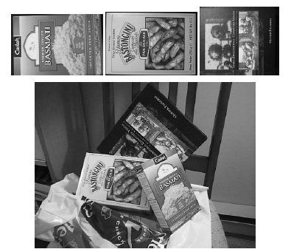
Fitting an affine transformation
Figures from David Lowe, ICCV 1999

Slide 48
Fitting an affine transformation

Slide 49
Fitting an affine transformation

Slide 50
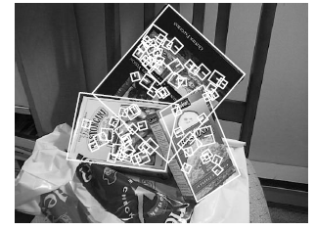
Fitting an affine transformation
Figures from David Lowe, ICCV 1999

Slide 51
Today
Interactive segmentation
Feature-based alignment
2D transformations
Affine fit
RANSAC

Slide 52
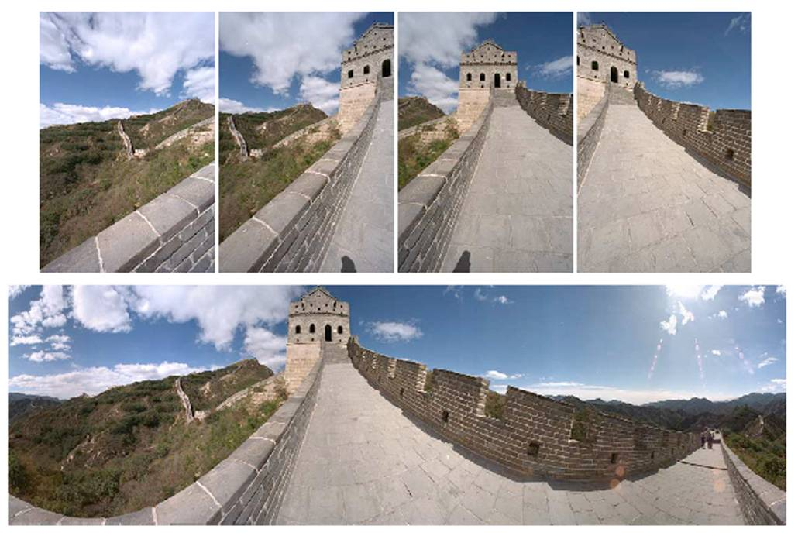
Outliers
Outliers can hurt the quality of our parameter estimates, e.g.,
an erroneous pair of matching points from two images
an edge point that is noise, or doesn’t belong to the line we are fitting.
Kristen Grauman

Slide 53
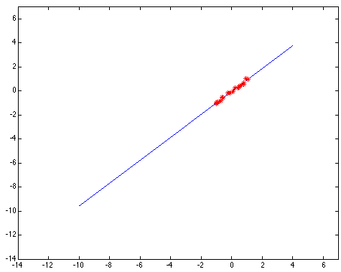
Outliers affect least squares fit
Slide credit: Kristen Grauman
Notes:
53

Slide 54
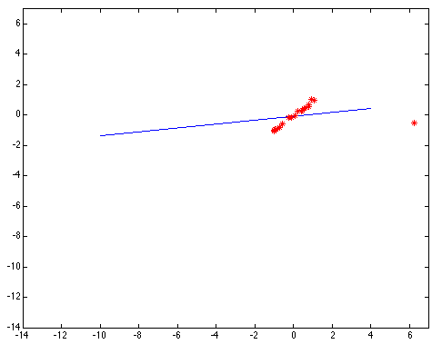
Outliers affect least squares fit
Slide credit: Kristen Grauman
Notes:
54

Slide 55
RANSAC
RANdom Sample Consensus
Approach: we want to avoid the impact of outliers, so let’s look for “inliers”, and use those only.
Intuition: if an outlier is chosen to compute the current fit, then the resulting line won’t have much support from rest of the points.
Slide credit: Kristen Grauman

Slide 56
RANSAC: General form
RANSAC loop:
Randomly select a seed group of points on which to base transformation estimate
Compute transformation from seed group
Find inliers to this transformation
If the number of inliers is sufficiently large, re-compute estimate of transformation on all of the inliers
Keep the transformation with the largest number of inliers
Slide credit: Kristen Grauman

Slide 57
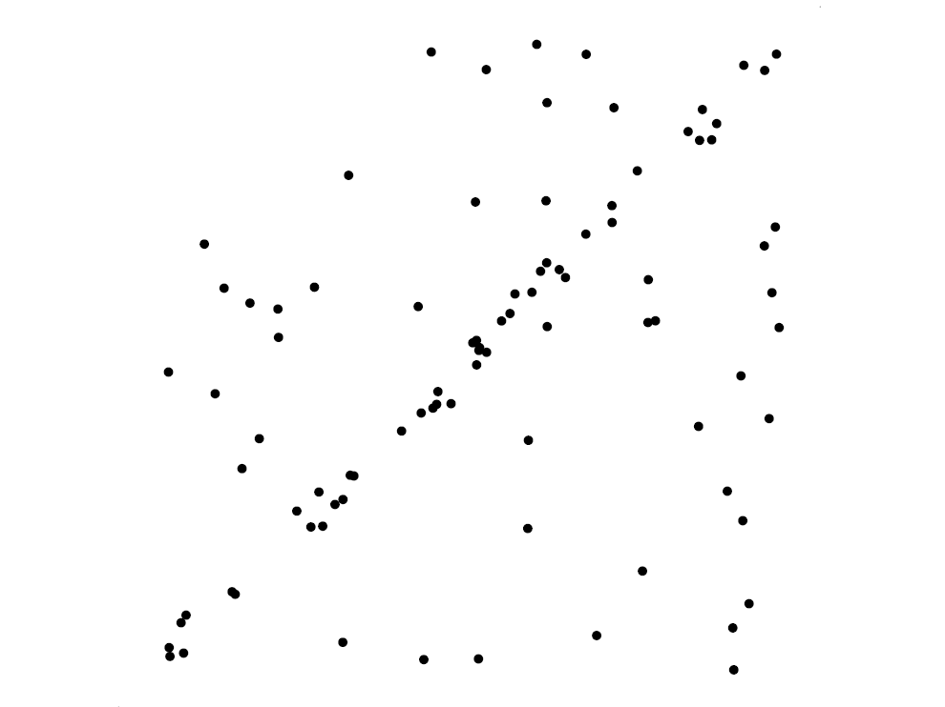
RANSAC for line fitting example
Source: R. Raguram
Lana Lazebnik

Slide 58
RANSAC for line fitting example
Least-squares fit
Source: R. Raguram
Lana Lazebnik

Slide 59
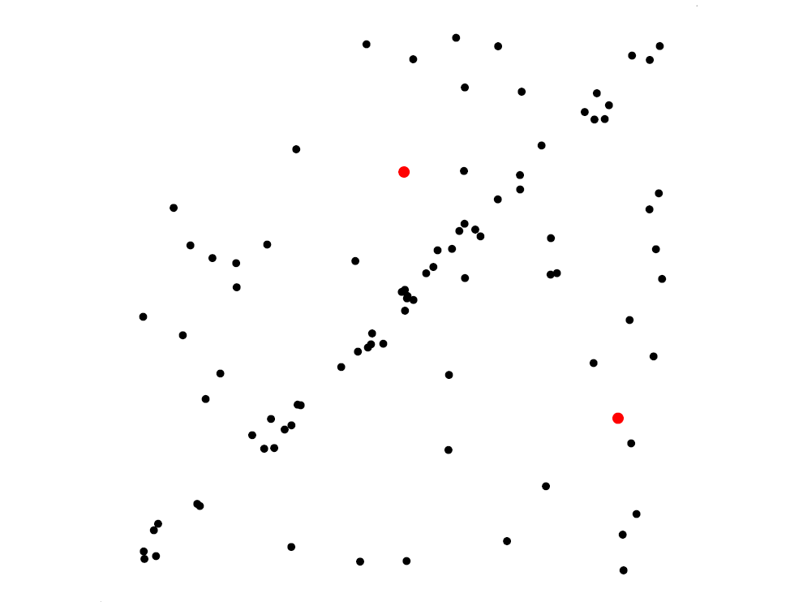
RANSAC for line fitting example
Randomly select minimal subset of points
Source: R. Raguram
Lana Lazebnik

Slide 60
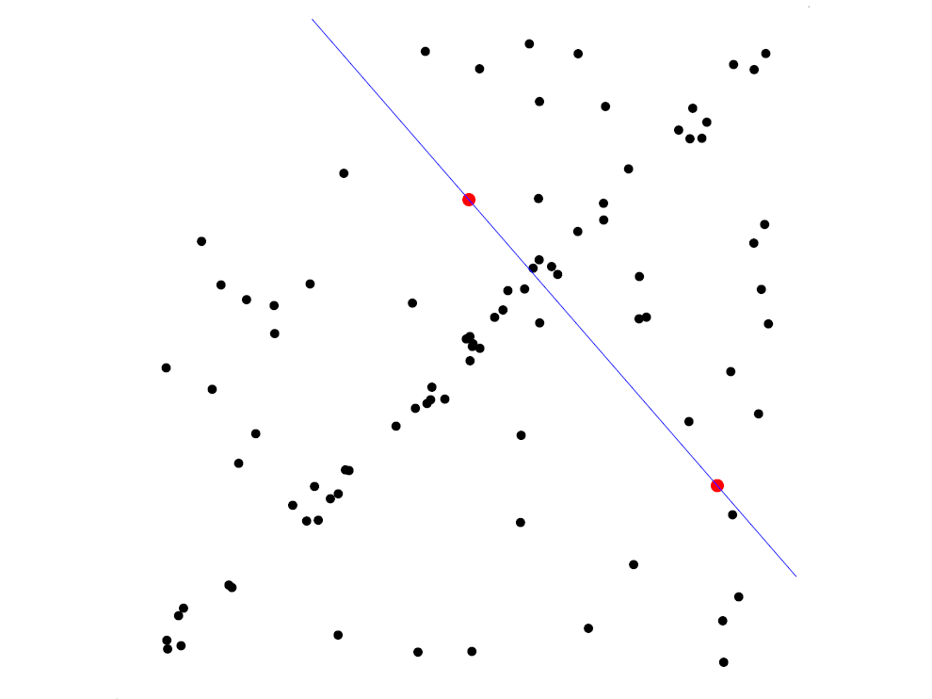
RANSAC for line fitting example
Randomly select minimal subset of points
Hypothesize a model
Source: R. Raguram
Lana Lazebnik

Slide 61
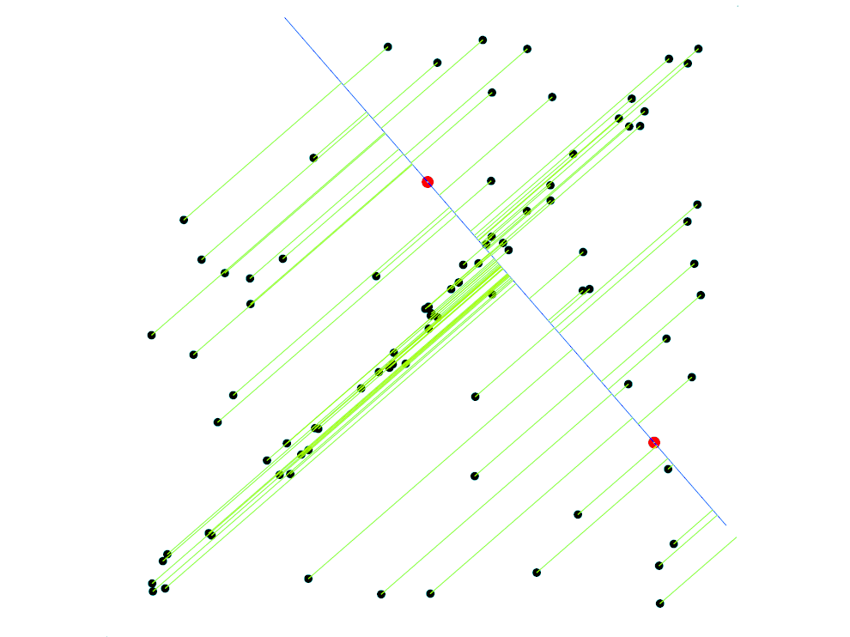
RANSAC for line fitting example
Randomly select minimal subset of points
Hypothesize a model
Compute error function
Source: R. Raguram
Lana Lazebnik

Slide 62
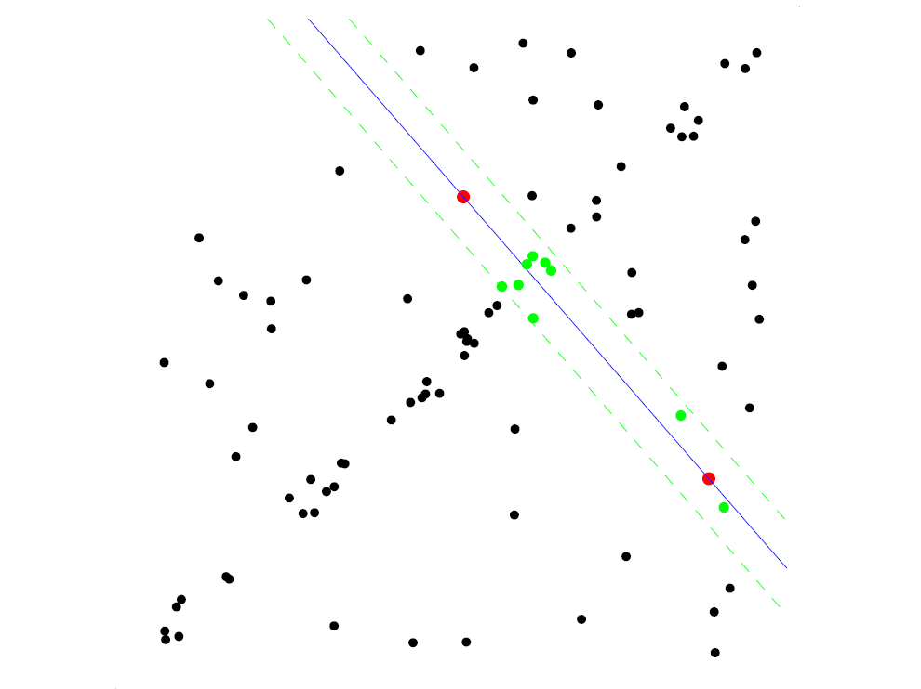
RANSAC for line fitting example
Randomly select minimal subset of points
Hypothesize a model
Compute error function
Select points consistent with model
Source: R. Raguram
Lana Lazebnik

Slide 63
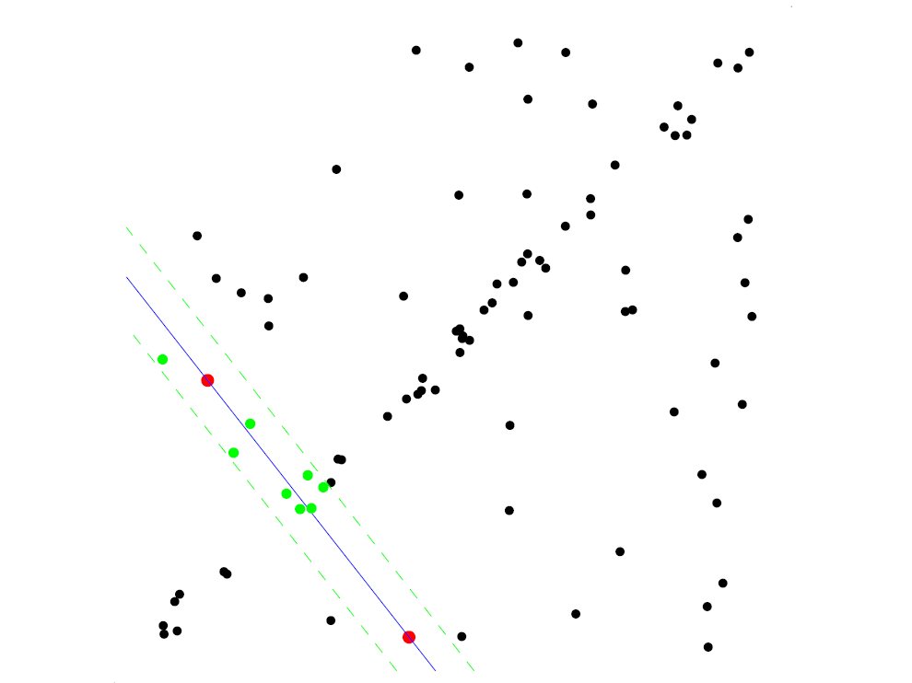
RANSAC for line fitting example
Randomly select minimal subset of points
Hypothesize a model
Compute error function
Select points consistent with model
Repeat hypothesize-and-verify loop
Source: R. Raguram
Lana Lazebnik

Slide 64
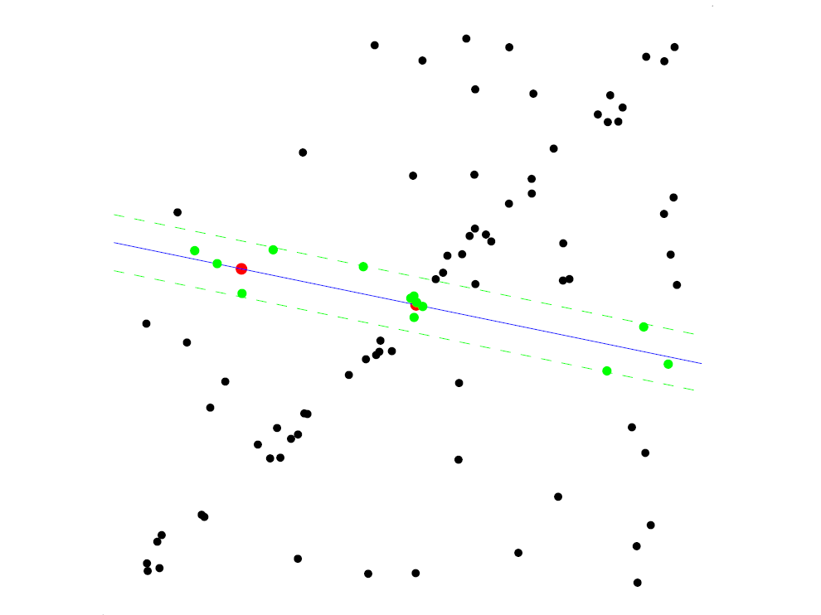
RANSAC for line fitting example
Randomly select minimal subset of points
Hypothesize a model
Compute error function
Select points consistent with model
Repeat hypothesize-and-verify loop
Source: R. Raguram
Lana Lazebnik

Slide 65
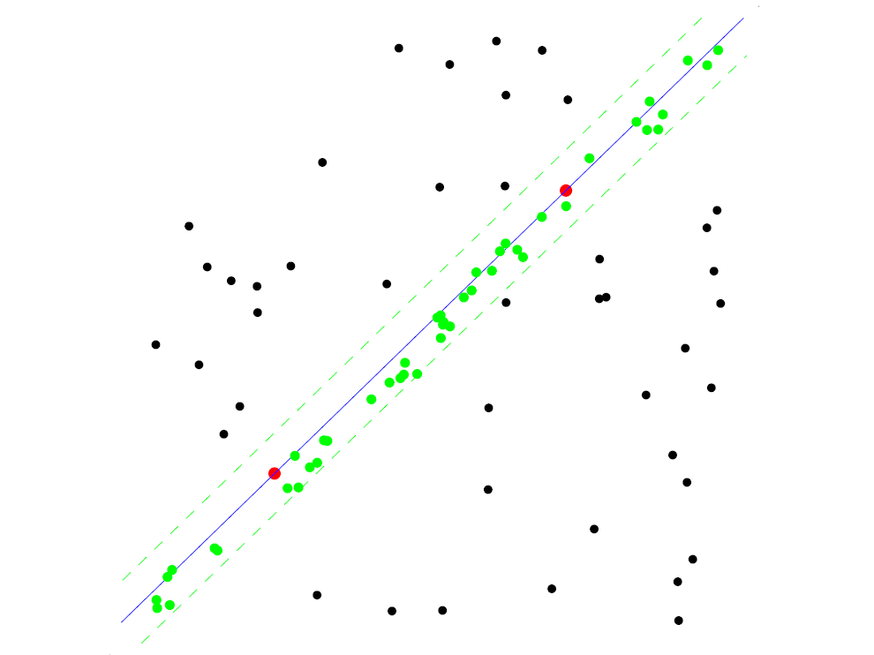
RANSAC for line fitting example
Randomly select minimal subset of points
Hypothesize a model
Compute error function
Select points consistent with model
Repeat hypothesize-and-verify loop
Source: R. Raguram
Lana Lazebnik

Slide 66
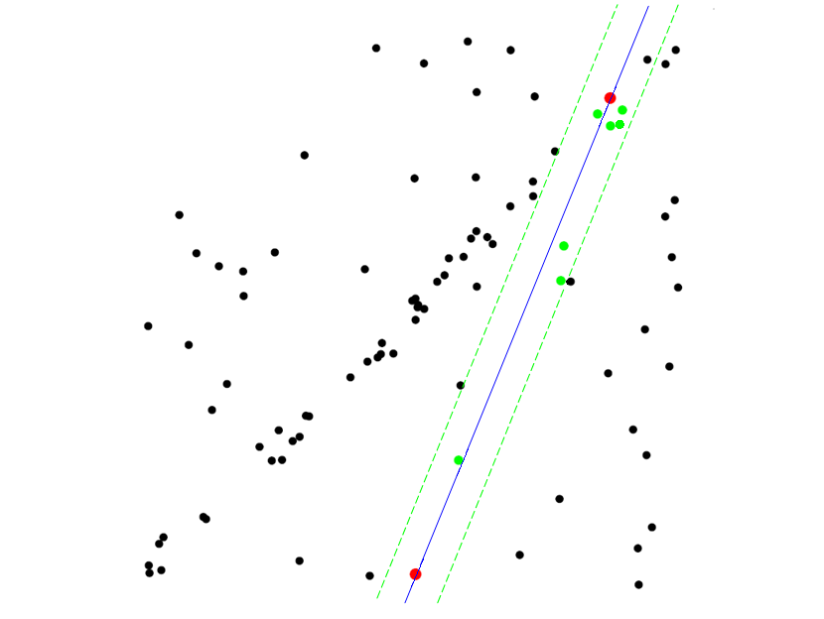
RANSAC for line fitting example
Randomly select minimal subset of points
Hypothesize a model
Compute error function
Select points consistent with model
Repeat hypothesize-and-verify loop
Source: R. Raguram
Lana Lazebnik
Notes:
66

Slide 67
RANSAC for line fitting
Repeat N times:
Draw s points uniformly at random
Fit line to these s points
Find inliers to this line among the remaining points (i.e., points whose distance from the line is less than t)
If there are d or more inliers, accept the line and refit using all inliers
Lana Lazebnik

Slide 68
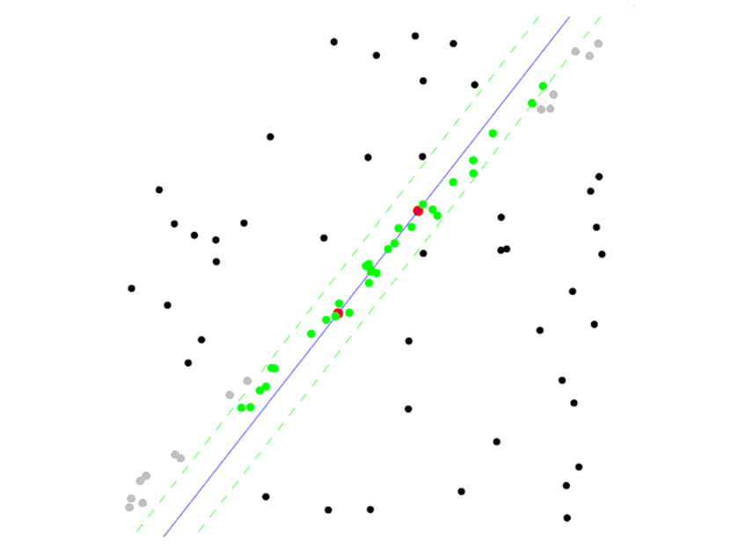
RANSAC pros and cons
Pros
Simple and general
Applicable to many different problems
Often works well in practice
Cons
Lots of parameters to tune
Doesn’t work well for low inlier ratios (too many iterations, or can fail completely)
Can’t always get a good initialization of the model based on the minimum number of samples
Lana Lazebnik

Slide 69
Today
Interactive segmentation
Feature-based alignment
2D transformations
Affine fit
RANSAC

Slide 70
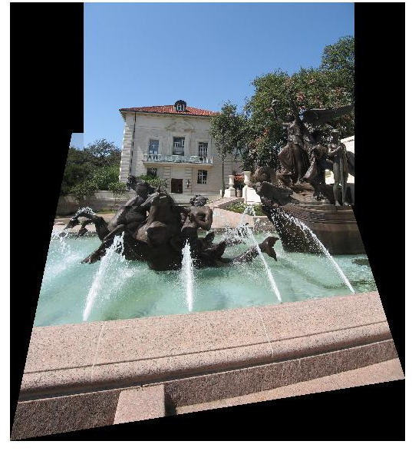

Coming up: alignment and image stitching

Slide 71
Questions?
See you Thursday!

